Slide 1


Finclusion to Fintech

Slide 2
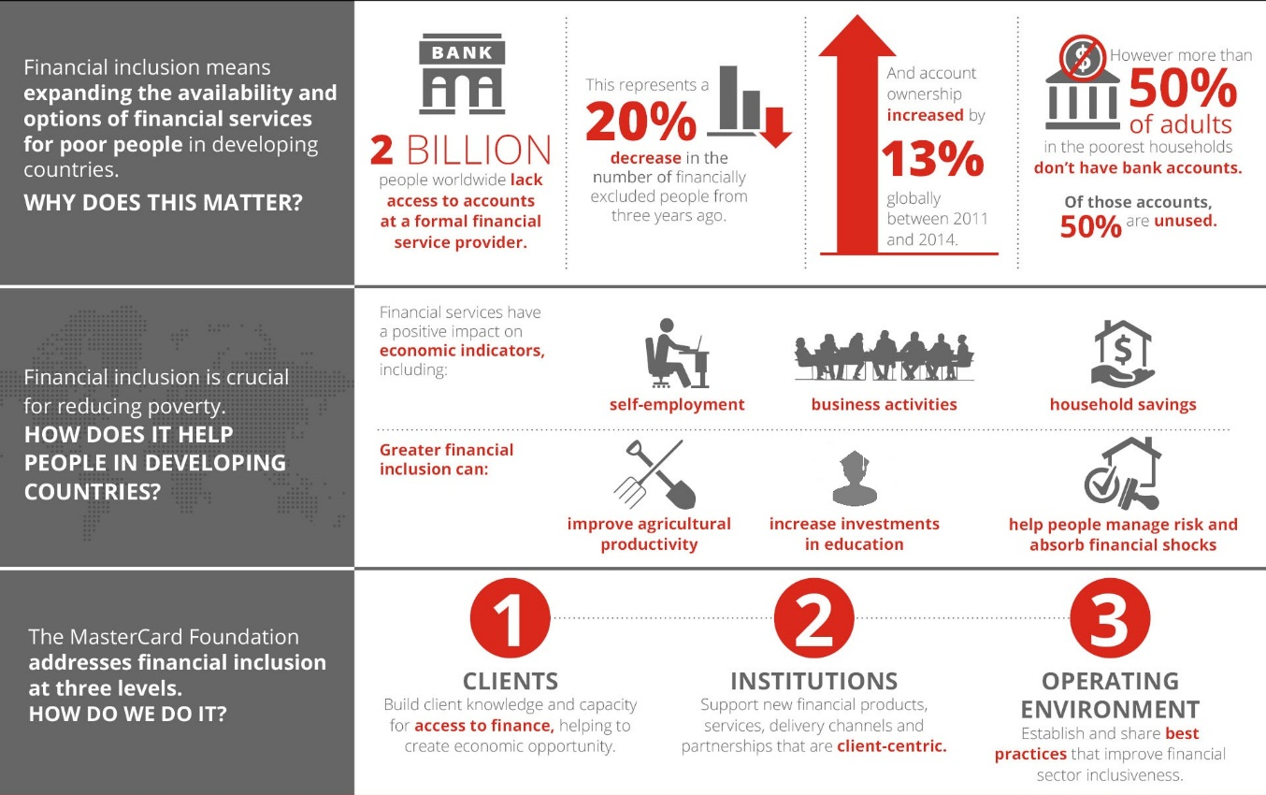

Slide 3
Just over a decade ago, advancements in mobile technology led to the development of mobile money and agent banking (referred to as digital finance. Digital finance provided a revolutionary new method for delivering financial services to the mass markets of the developing world.
While the development of digital finance has provided access to financial services to hundreds of millions of new customers, only a small fraction of that population has actually chosen to use it. At the end of 2016, only 21% of the 556 million globally registered mobile money accounts were active on a 30-day basis.
Further, within this small proportion of adaptors, use is infrequent and limited to some very specific activities. On average, active mobile money users conduct only 11 transactions per month.
The problem here is that, while a completely new paradigm has been developed to deliver financial services, for the most part, the services themselves have not evolved
In many cases, digital finance systems in the developing world are delivering services designed for relatively high-income people with salaries, to people with some very different financial needs. Therefore, these formal financial services remain uncompetitive with many of the informal money management techniques that have been used by the mass market for generations. This is a major reason why access has failed to translate into widespread usage.

Slide 4
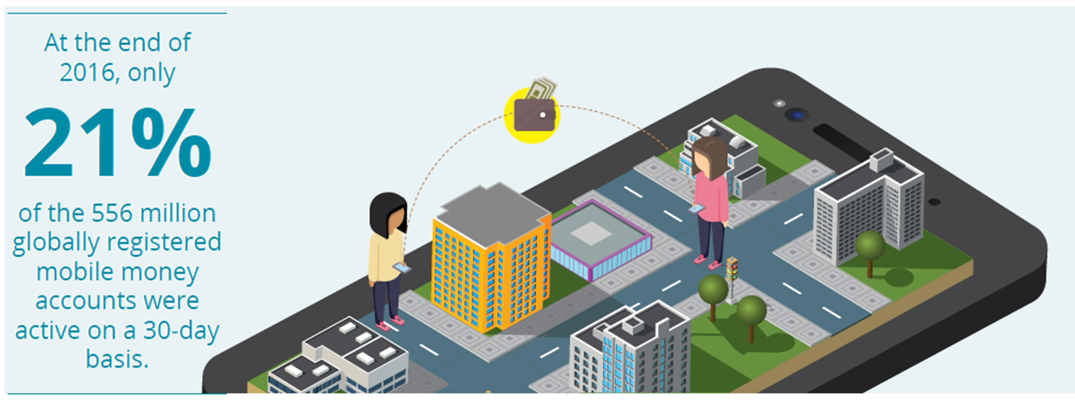

Slide 5
Companies, financial inclusion experts, and governmental policy makers have all focused on buttressing the growth of formal finance because it has important advantages in comparison to informal services. Specifically, formal finance is easier to scale than informal financial services, and therefore more conducive to economies of scale and regulation to protect consumer interests. This makes them useful for mass payment systems like retail purchases, employers dispensing wages, safe storage of value and regulated lending.

Slide 6
However, most formal finance services were designed generations ago, before digital systems were developed to deliver them, and at a time when the main focus of retail finance was on salaried workers. The constraints of these antiquated systems has meant that scaling has required standardising them into generic products. This served the masses of salaried workers well, given their predictable incomes and expenditures, and their overall financial objectives of safely storing accumulated wealth and building assets.
Low-income people, on the other hand, have more volatile incomes and expenditures, and therefore more variable financial needs that require complex financial management techniques. Such techniques are hard to standardise, and generally have only managed to scale informally. Enormous public programmes have been designed to help low-income people manage their money, by extending financial access to include bank accounts and mobile money accounts to this “unbanked” population. Judging the level of success of these programmes is a complex task, and the subject of continued debate within the industry.

Slide 8
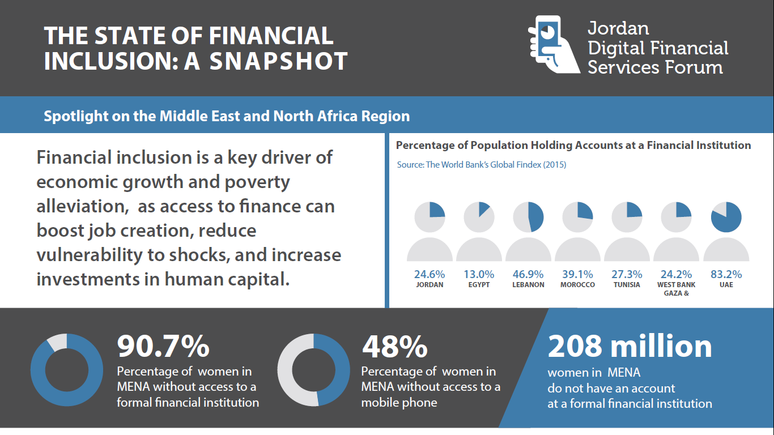
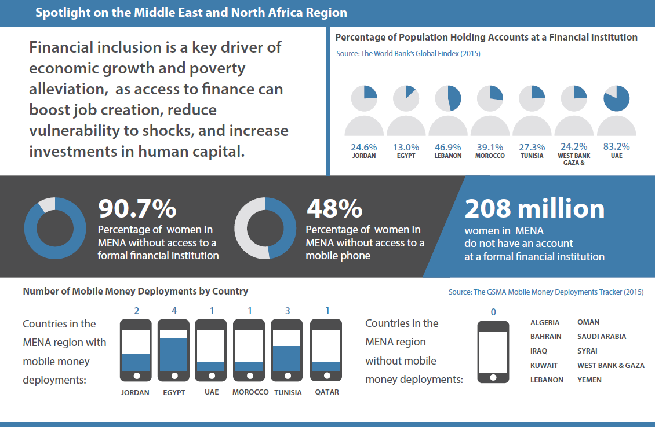

Slide 9
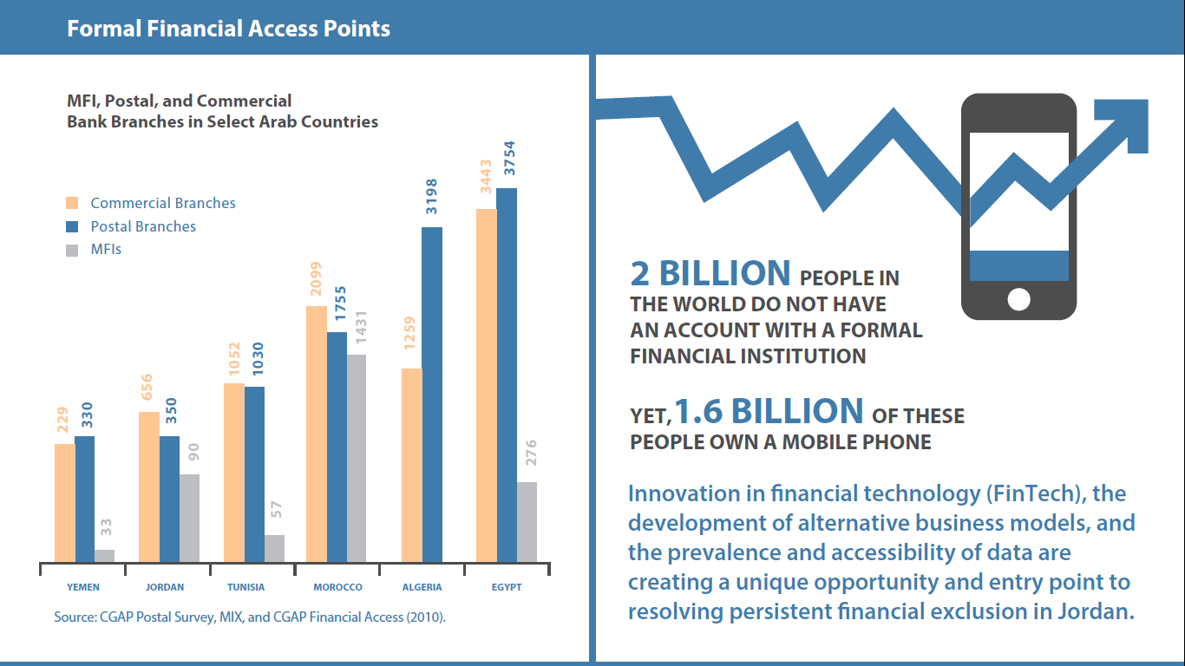

Slide 10
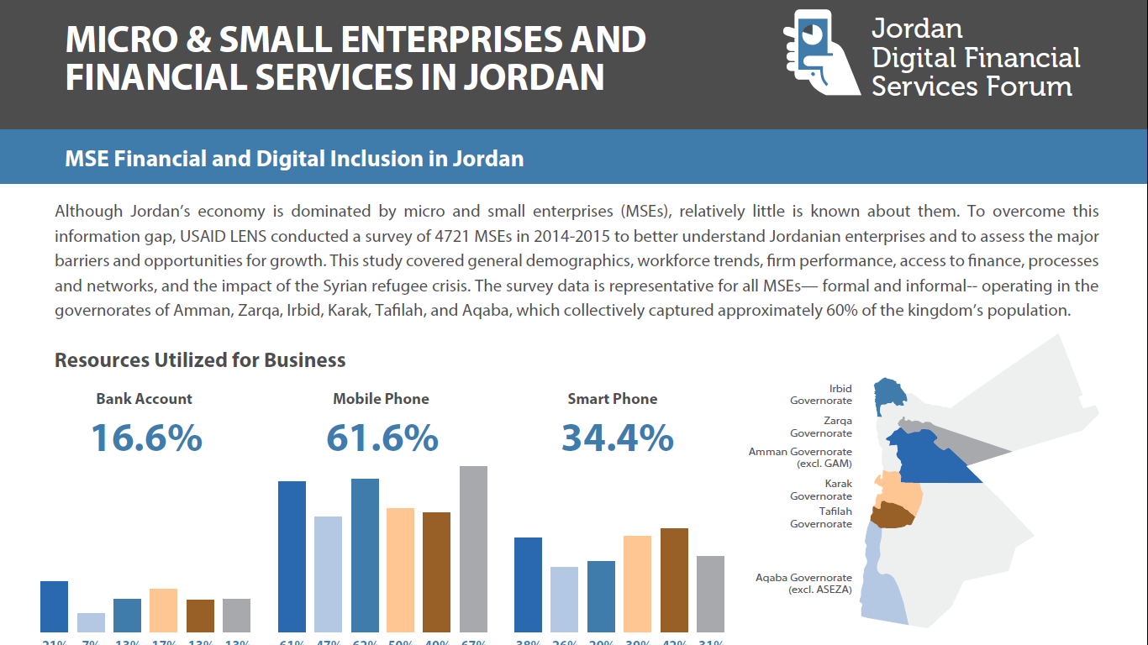
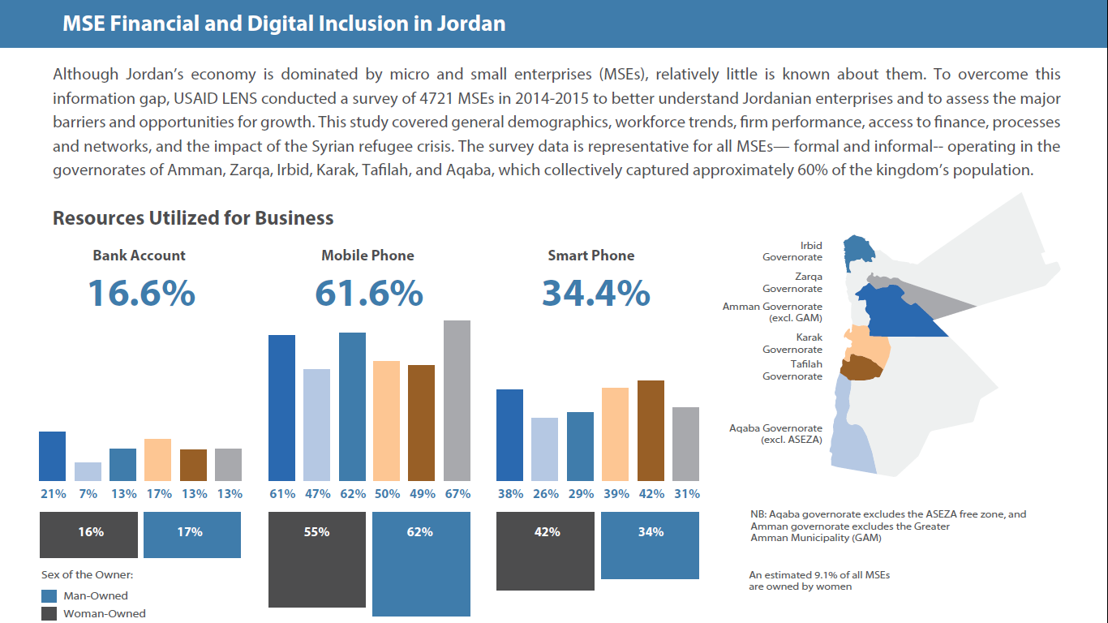

Slide 11
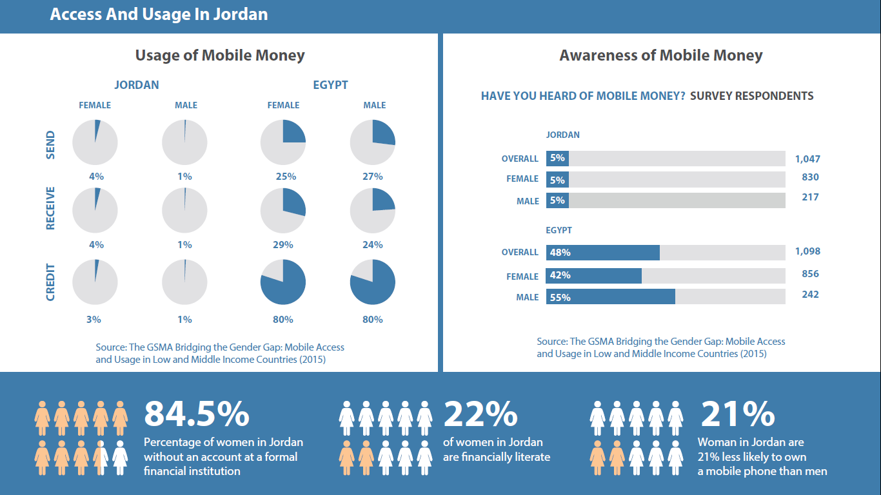

Slide 12
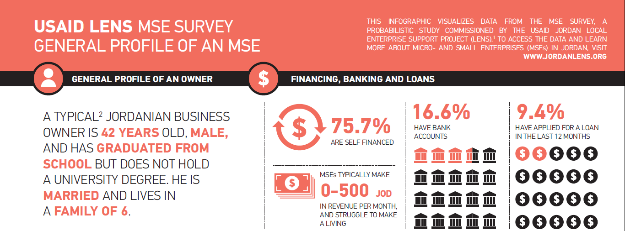
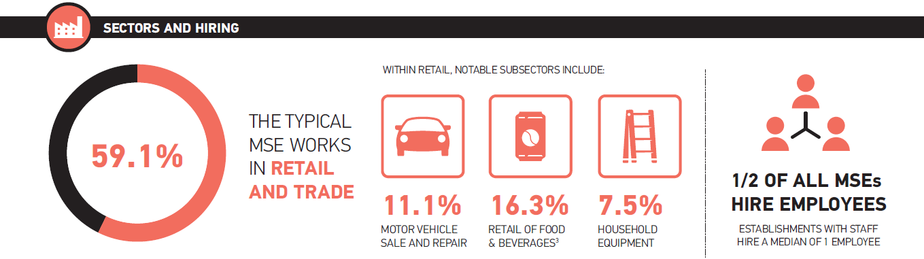

Slide 13
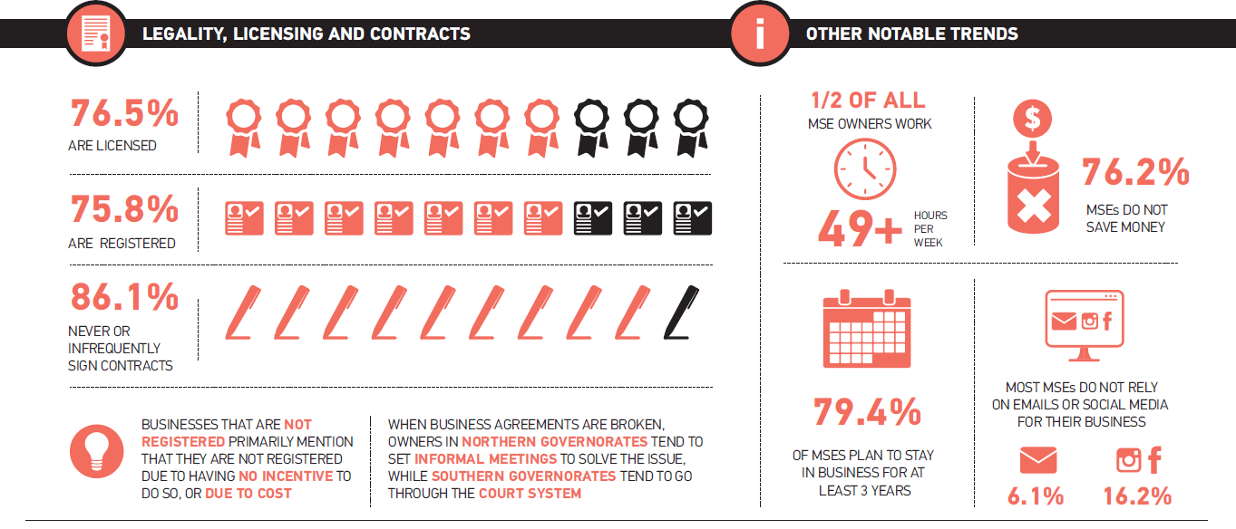

Slide 14

1 | Net loan portfolio | 1098032
2 | Total number of active borrowers | 2,306
3 | Total No of staff | 30
4 | No. of Loan Officers | 9

Slide 15
Ethmar Utilizes technology and innovative applications.
Ethmar is using technology to maximize its business productivity. Business productivity software ensures Ethmar to have the tools to overcome the challenges of executing on strategy every day and prospering in today's economic times.
Ethmar’s business productivity software drives business processes more efficiently to gain optimal results. It has developed its own Microfinance System, along with middleware channels that grantee a high level of connection with management, clients, vendors, employees and society.

Slide 16
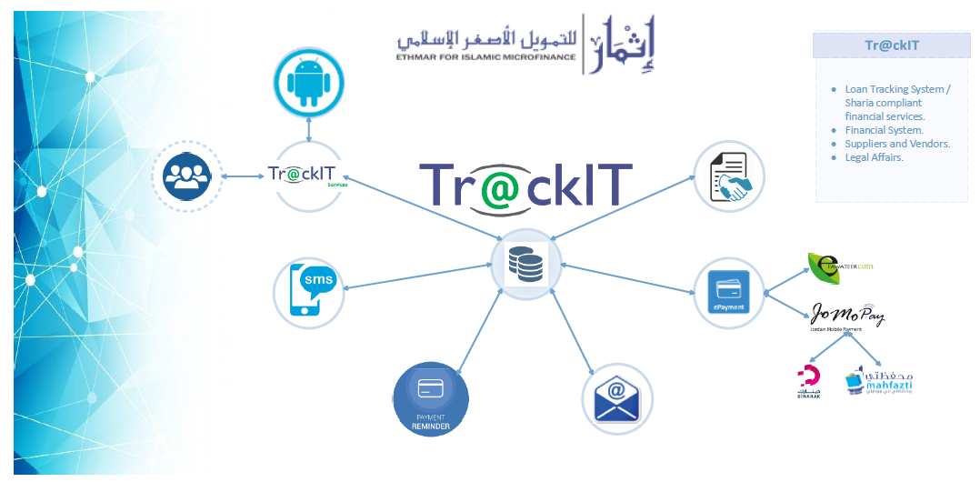
Moods
Sales Installment
Ju’ala
Murabaha
Istesna’
Murabaha restricted investment agency

Slide 17
